Slide 1
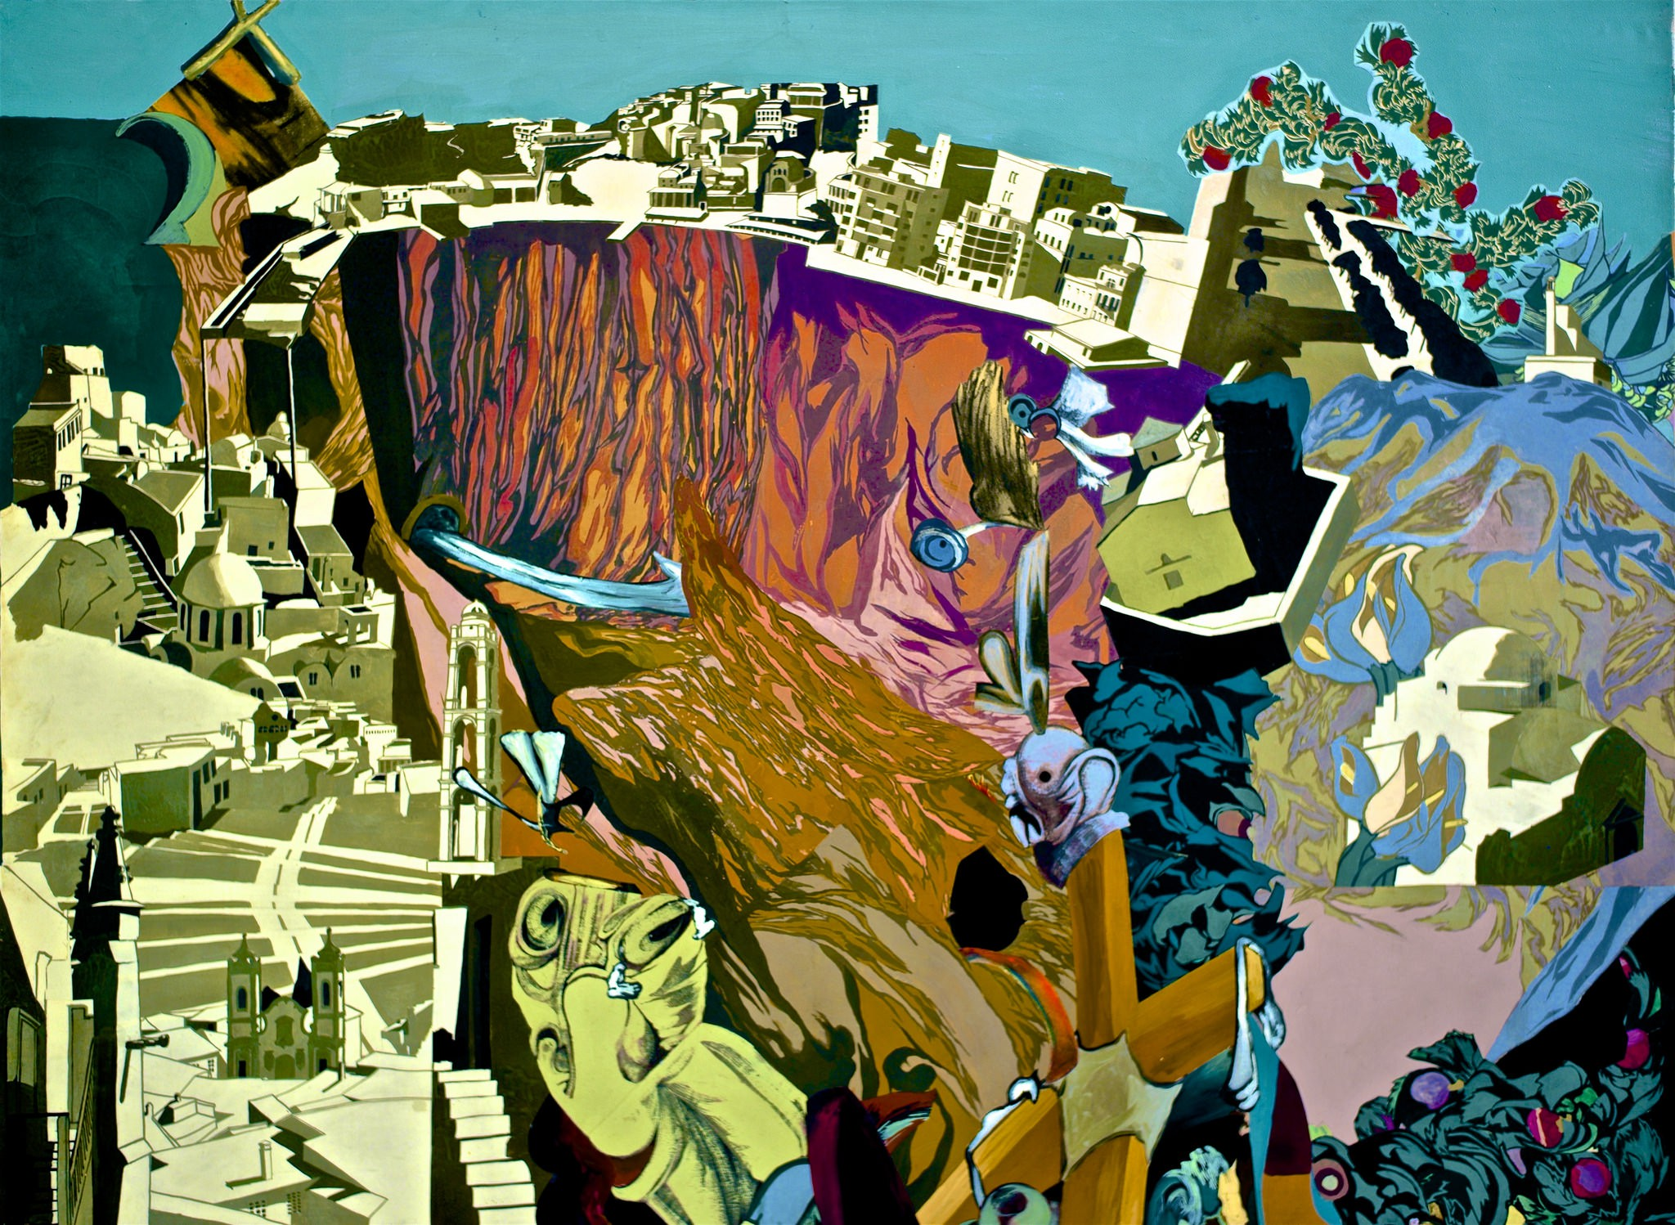

Slide 2
Paulo Rego Born Jan 1935 – Nam of painting unknown
What is happening in this picture?
What can you see?
How does the picture make you feel?
Could you think of a story to link to this painting?
What do you like/dislike about this style of art?
Rego was born on 26 January 1935 in Lisbon, Portugal.[5] Her father was an electrical engineer who worked for the Marconi Company. Although this gave her a comfortable middle class home, the family was divided in 1936 when her father was posted to work in the United Kingdom. Accompanied by Rego's mother, they left Rego behind in Portugal in the care of her grandmother until 1939. Her grandmother was to become a significant figure in Rego's life as she learnt many of the traditional folktales that would one day make their way into her art work from her grandmother and the family maid.
With an astounding career spanning over five decades as a member of artist collective The London Group alongside David Hockney, R.B. Kitaj and Frank Auerbach, Paula Rego’s work has changed and transformed from abstract to representational. She incorporates the themes and characters from the folklore of her native Portugal, creating intricate, colorful works teeming with vibrancy and political consciousness. Since becoming the first ever artist-in-residence at London’s National Gallery, her work has become simultaneously cleaner and more disturbing.

